Slide 1







Connecting
People
About
Click here to find help
Click here to find how to help
My help bucket
Walk dog
Drop food
Drop medication
Walk dog

Slide 2
Connecting
People
About
Click here to find how to help
Click here to find help
My help bucket
My help bucket
Walk dog
Drop food
Drop medication
Walk dog

Slide 3
Connecting
People
About
Facebook log in
Click here to find help
Click here to find how to help
My help bucket
Walk dog
Drop food
Drop medication
Walk dog

Slide 4
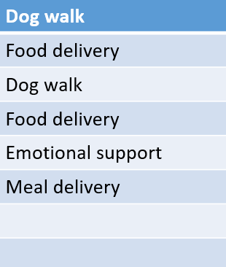
What can I help you with? | Address of origin | Destination address
Submit
Notes:
What do you want?
Da 3 opcoes Where is the address to get it? Where to deliver it? -submit button

Slide 5



C
HEOOAOOAMKM
Connecting
People
About us
Dog walk
Food delivery
Dog walk
Food delivery
Emotional support
Meal delivery
Marissol Ferreira Karczeski
Submit
Notes:
Qdo clica submit, some a linha de opcao e vai pra tela rosa a info – manda uma api call que armazena no servidor com aquela info. A tela vai refresh sem aquela opcao que foi escolhida. A api filtra. To oferecendo ajuda aqui

